Slide 1
Biological Modeling of Neural Networks:
Week 13 – Membrane Potential Densities and Fokker-Planck Equation
13.1 Review: Integrate-and-fire
- stochastic spike arrival
13.2 Density of membrane potential
- Continuity equation
13.3 Flux
- jump flux
- drift flux
13.4. Fokker –Planck Equation
- free solution
13.5. Threshold and reset
- time dependent activity
- network states
Week 13 – Membrane potential densities and Fokker-Planck
Wulfram Gerstner
EPFL, Lausanne, Switzerland
Notes:
2013: First two lectures went well, the final lectures with the Brunel results needs still some extra work on the slides.

Slide 2
Week 13-part 1: Review: integrate-and-fire-type models
Spike emission
j
i
Spike reception
-spikes are events
-threshold
-spike/reset/refractoriness

Slide 3
Week 13-part 1: Review: leaky integrate-and-fire model
j
i
I
If firing:

Slide 4
Week 13-part 1: Review: leaky integrate-and-fire model
LIF
If firing:
I=0
I>0
flow (drift)
towards
threshold
u
repetitive
u
u
resting
t
t

Slide 5
Week 13-part 1: Review: microscopic vs. macroscopic
I(t)

Slide 6
Week 13-part 1: Review: homogeneous population
t
?
I(t)
Homogeneous network:
each neuron receives input
from k neurons in network
-each neuron receives the same
(mean) external input
t
population
activity

Slide 7
Week 13-part 1: Review: diffusive noise/stochastic spike arrival
Stochastic spike arrival:
excitation, total rate Re
inhibition, total rate Ri
Synaptic current pulses
EPSC
IPSC
u
Langevin equation,
Ornstein Uhlenbeck process

Slide 8
Biological Modeling of Neural Networks:
Week 13 part 2 – Membrane Potential Densities
13.1 Review: Integrate-and-fire
- stochastic spike arrival
13.2 Density of membrane potential
-
13.3 Flux
-
-
13.4. Fokker –Planck Equation
-
-
13.5. Threshold and reset
-
Week 13 – Membrane potential densities and Fokker-Planck
Wulfram Gerstner
EPFL, Lausanne, Switzerland
Notes:
Lecture 1, includes the
Blackboard part of the Salzman et al experiment
Blackboard part Reduction from 3 to 2 dimensions
Lecture 2
continuation of blackboard with linearization of the inhibitory neurons
Then Exercise 1, nullclines etc. from 10:25-10:38
Afterwards, the shifting nullclines, discussion of regimes, fixed points etc.
3rd lecture: Free will (12.5)

Slide 9
Week 13-part 2: membrane potential density
Blackboard:
density of potentials?
For any arbitrary neuron in the population
EPSC
IPSC
external current
input
excitatory input spikes

Slide 10
Week 13-part 2: continuity equation

Slide 11
Exercise 1: flux caused by stochastic spike arrival
Membrane potential density
Next lecture:
10h15
u
u
p(u)
Reference level u0
a) Jump at time t
What is the flux
across u0?
b)
spike arrival rate
c)
spike arrival rate

Slide 12
Biological Modeling of Neural Networks:
Week 13 – Membrane Potential Densities and Fokker-Planck Equation
13.1 Review: Integrate-and-fire
- stochastic spike arrival
13.2 Density of membrane potential
- continuity equation
-
13.3 Flux
- jump flux
- drift flux
13.4. Fokker –Planck Equation
-
13.5. Threshold and reset
-
Week 13 – Membrane potential densities and Fokker-Planck
Wulfram Gerstner
EPFL, Lausanne, Switzerland

Slide 13
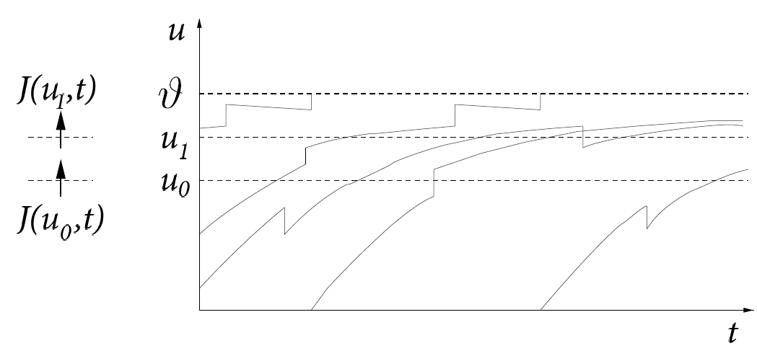
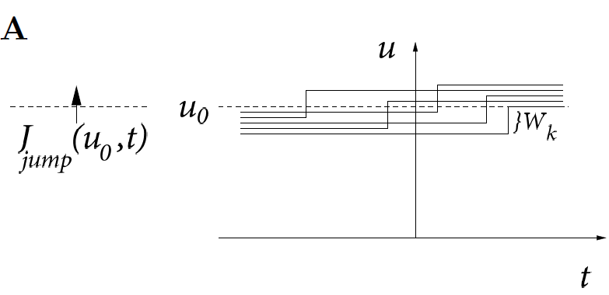
Week 13-part 2: membrane potential density: flux by jumps

Slide 14
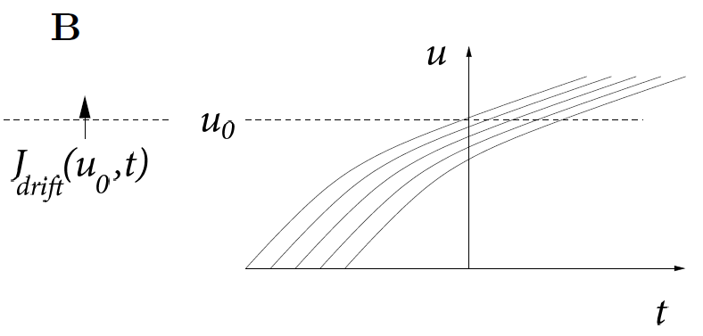
Week 13-part 2: membrane potential density: flux by drift

Slide 15
flux – two possibilities
Membrane potential density
u
What is the flux
across u0?
u
p(u)
Reference level u0
Jumps caused at
a)
flux caused by jumps due to
stochastic spike arrival
spike arrival rate
Blackboard:
Slope and
density of potentials
b)
flux caused by
systematic drift

Slide 16
Biological Modeling of Neural Networks:
Week 13 – Membrane Potential Densities and Fokker-Planck Equation
13.1 Review: Integrate-and-fire
- stochastic spike arrival
13.2 Density of membrane potential
-
13.3 Flux
- continuity equation
13.4. Fokker –Planck Equation
- source and sink
-
13.5. Threshold and reset
-
Week 13 – Membrane potential densities and Fokker-Planck
Wulfram Gerstner
EPFL, Lausanne, Switzerland

Slide 17
Week 13-part 4: from continuity equation to Fokker-Planck
Blackboard:
Derive Fokker-Planck
equation
For any arbitrary neuron in the population
EPSC
IPSC
external input
Continuity equation:
Flux: - jump (spike arrival)
- drift (slope of trajectory)

Slide 18
Week 13-part 4: Fokker-Planck equation
Membrane potential density
u
p(u)
Fokker-Planck
drift
diffusion
spike arrival rate

Slide 19
Exercise 2: solution of free Fokker-Planck equation
Membrane potential density: Gaussian
Next lecture:
11h25
u
constant input rates
no threshold
u
p(u)
Fokker-Planck
drift
diffusion
spike arrival rate

Slide 20
Biological Modeling of Neural Networks:
Week 13 – Membrane Potential Densities and Fokker-Planck Equation
13.1 Review: Integrate-and-fire
- stochastic spike arrival
13.2 Density of membrane potential
-
13.3 Flux
- continuity equation
13.4. Fokker –Planck Equation
-
-
13.5. Threshold and reset
-
Week 13 – Membrane potential densities and Fokker-Planck
Wulfram Gerstner
EPFL, Lausanne, Switzerland

Slide 21
Week 13-part 5: Threshold and reset (sink and source terms)
Membrane potential density
u
u
p(u)
blackboard
Fokker-Planck
drift
diffusion
spike arrival rate

Slide 22
Week 13-part 5: population firing rate A(t)
Membrane potential density
u
u
p(u)
blackboard
Population Firing rate A(t): flux at threshold

Slide 23
Week 13-part 5: population firing rate A(t) = single neuron rate
Synaptic current pulses
EPSC
IPSC
I
frequency
f
with noise
effective noise current

Slide 24
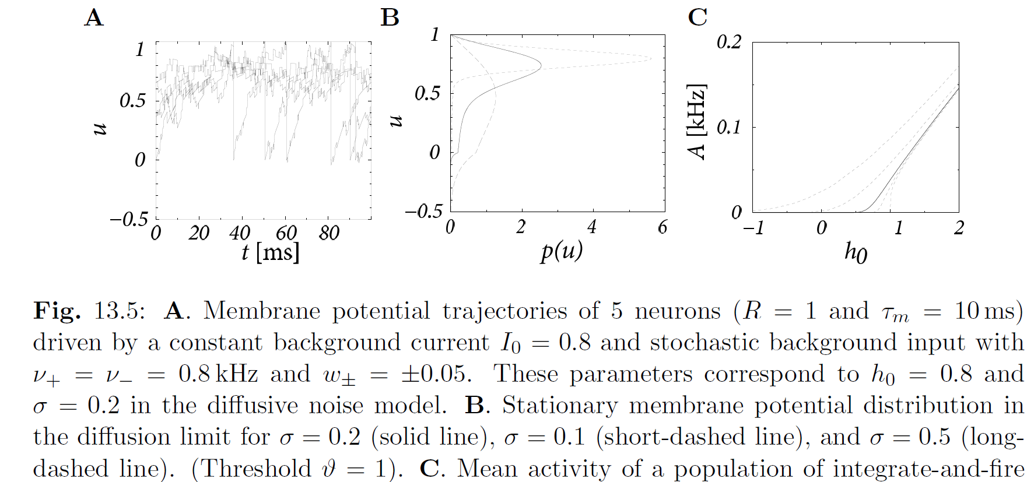
Week 13-part 5: membrane potential density

Slide 25
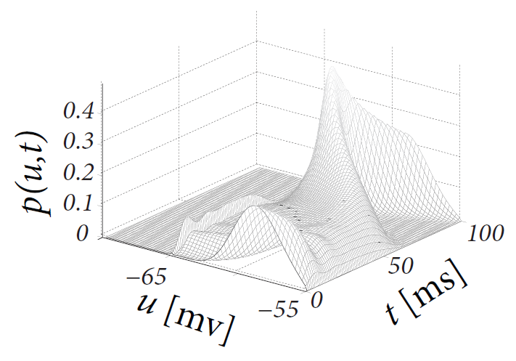
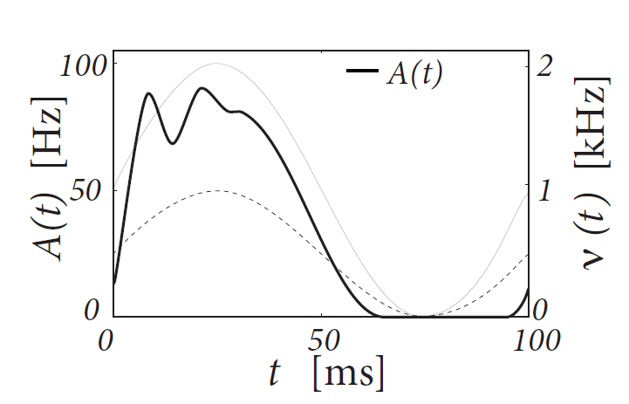
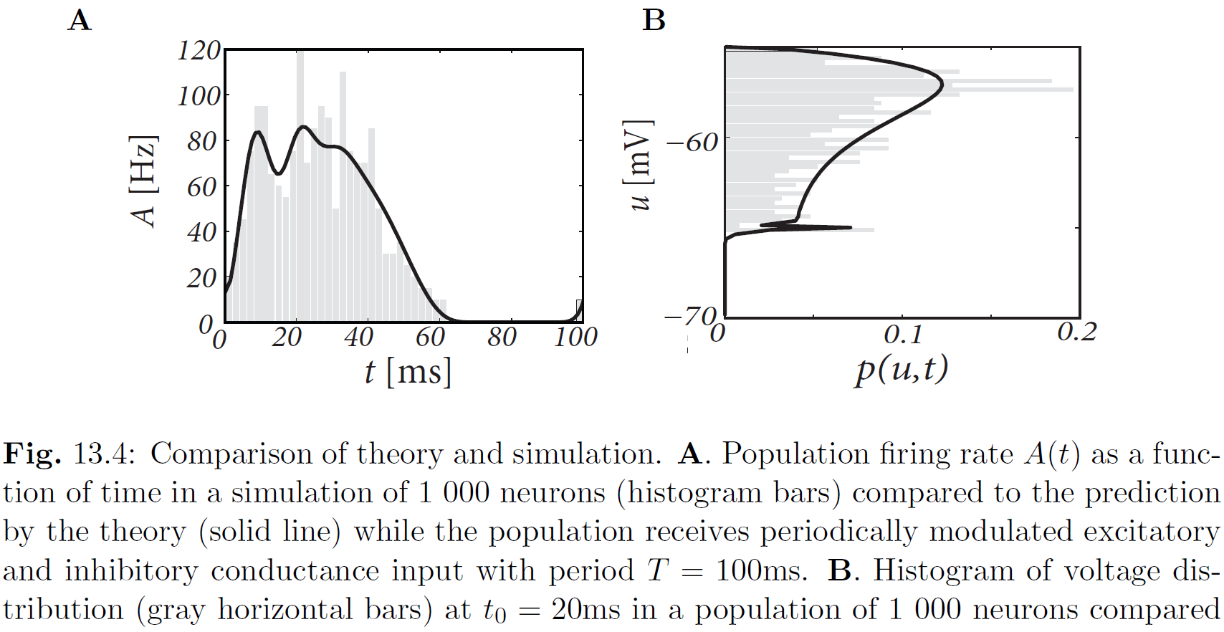
Week 13-part 5: population activity, time-dependent
Nykamp+Tranchina,
2000

Slide 26
Week 13-part 5: network states
frequency
f
with noise
mean I(T) depends on state
Variance/noise depends on state
EPSC
IPSC

Slide 27
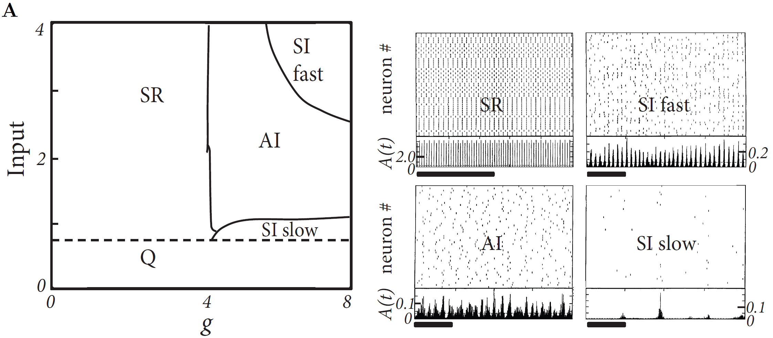
Week 13-part 5: network states
Brunel 2000

Slide 28
Exercise 3: Diffusive noise + Threshold
Membrane potential density
u
u
A=
Fokker-Planck
f
with noise
p(u)
Miniproject:
12h00
- Calculate distribution p(u)
- Determine population firing rate A

Slide 29
THE END
Sign up for:
- miniproject fraud detection interview

